Slide 1
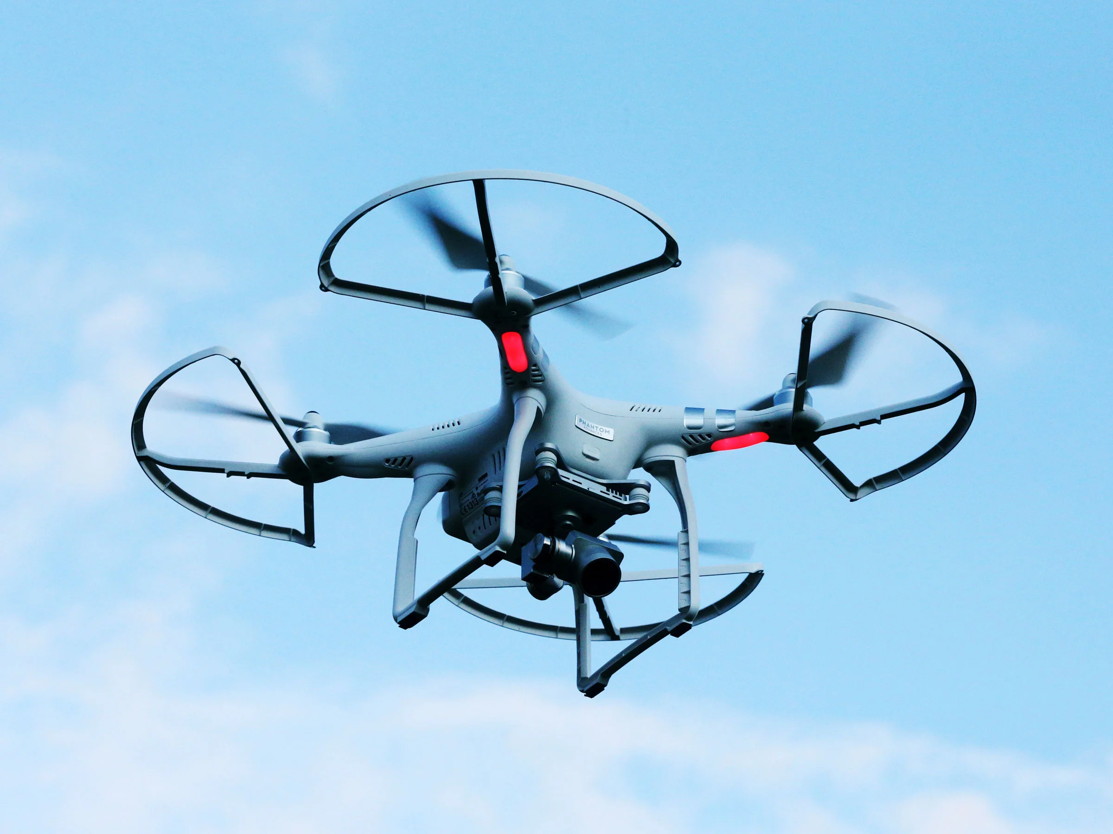
Drone Reality
Phillip Chazares, Chena Mac-Cephas, Vi Nguyen, Zachary Idrees

Slide 2

What is TAP?
Technology Ambassadors Program (TAP) is an outreach focused class offered by GGC where students with a passion for technology create projects that aim to expose the general public to a specific kind of technology in an informative and entertaining manner. Tap is fun Tap is life

Slide 3

TAP Class Experience
You get to meet new people and join a team
Work on team project
Show our passion to our audience
Having fun messing with drones
Improved resumes, essays, and professionalism with professors help.
It’s all about learning and having fun.

Slide 4

Presurvey
https://ggc.az1.qualtrics.com/jfe/form/SV_2gY79oskqdMa7C5

Slide 5

Goals
Showing people that technology is fun
Letting kids know that technology is awesome
Promoting active learning with drones

Slide 6
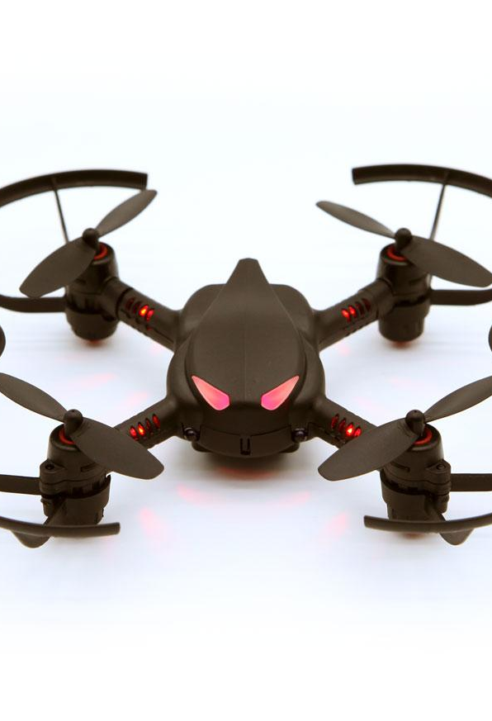
Codrone
Students will use Snap coding to send inputs to the Codrone
Block coding
It is an easier way to comprehend programming without code
The commands ranges from:
move,
turn,
go to, go to x: and y:,
etc...
Notes:
Snap coding from Rokit Brick is a block based way of coding created by the same manufacturers of the Codrone, Robolink

Slide 7
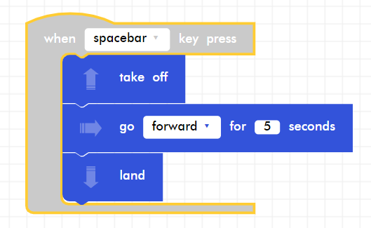
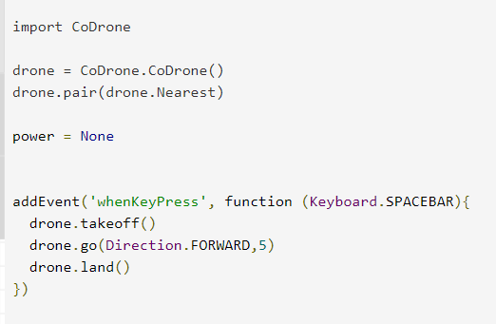
Block Coding vs Actual Coding
Block
Not Block, Real Programming

Slide 8
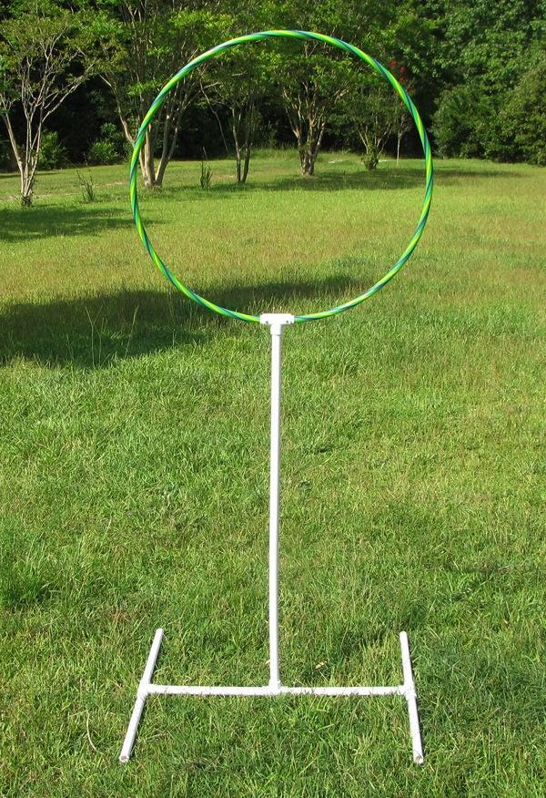
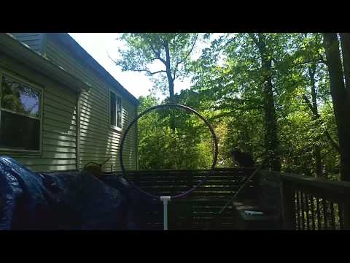
Project Description (video demo)
Original Project Description
Flying drones through hoop obstacles
Using commands to make the drone move
We code on a website and will need to bluetooth pair to a drone.
We will do it differently since we can’t stream the drones
Online Project Description
Use Rokit Brick IDE to command sprites
https://www.robolink.com/step-1a-installing-robolink-snap-windows/

Slide 9
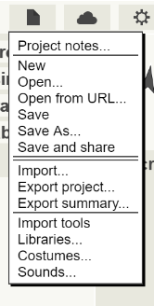

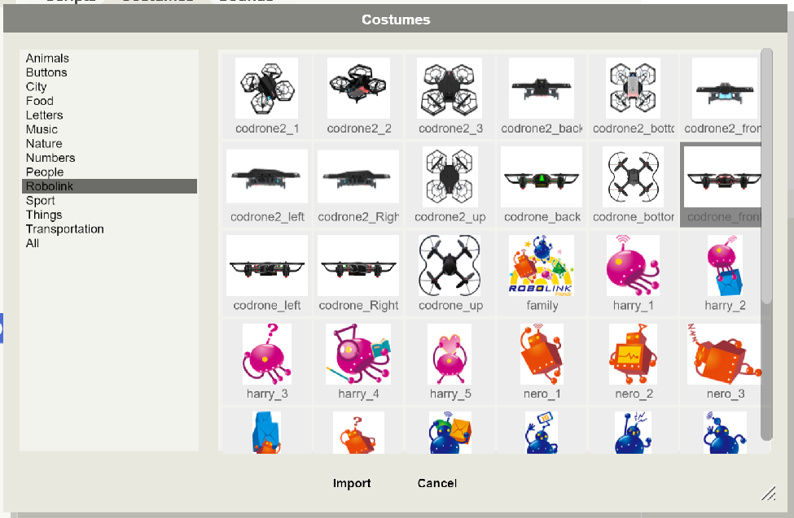
Workshop Demo
How to use the IDE
To the top right are color buttons
Green flag is to run code
Yellow pause button
Red hexagon to stop the code
You can change the sprite by clicking on File, Costumes, choose a drone image, then import, and cancel.

Slide 10


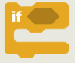

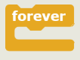
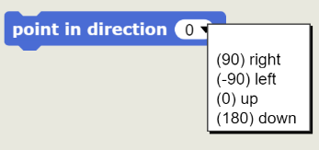
Drone controls
When the green flag is clicked the program starts
Move x steps will move the drones x steps
Steps put inside can be the smallest to the biggest number (it will move super slow or fast)
If statements lets you run a command if a condition is met
Example. If you don’t eat you will be HUNGRY!!!
Key (choose key) pressed lets you choose a keyboard button to use
Wait for the correct keyboard button to be pressed
There are repeat loops
Everything inside will repeat indefinitely
Point direction changes the direction the drone moves

Slide 11

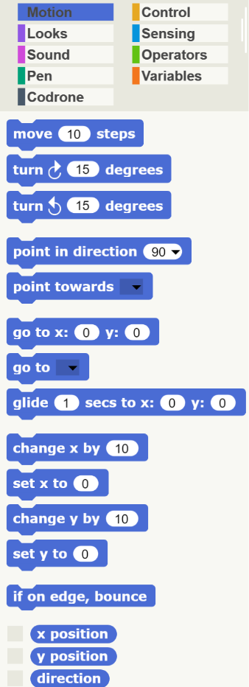
Demo
Here is a demonstration!
What would you like the drone to do?
https://youtu.be/9vEjv_1BP0khttps://youtu.e/9vEjv_1BP0k

Slide 12

Post Survey
https://ggc.az1.qualtrics.com/jfe/form/SV_55veZPK1tnRtHsF

Slide 13

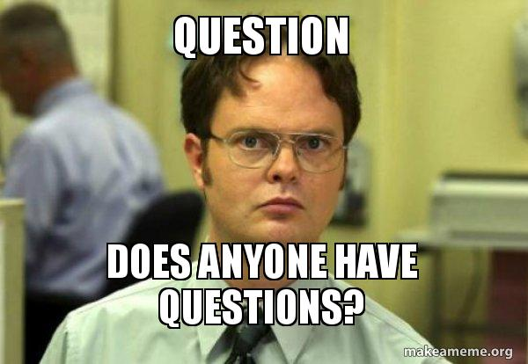
The End
Thank you!
Any questions?

